Slide 1
Brad Edmondson
Award-winning journalist and author of Ice Cream Social: The Struggle for the Soul of Ben & Jerry’s
Tom Szaky
Founder of TerraCycle and author of Outsmart Waste: The Modern Idea of Garbage and How to Think Our Way Out of It

Slide 2
In the beginning, there was an idea. How did Ben & Jerry’s and TerraCycle get started?

Slide 3
“Ben & Jerry’s, like a few other remarkable American companies, shows that another way of doing business is possible. The company has consistently walked the talk on environmental and social issues.”–Jeff Furman, the “Ampersand” of Ben & Jerry’s, from the foreword of Ice Cream Social

Slide 4
“Tom Szaky is a waste pioneer and an eco-capitalist. At age 31 he’s running a company that operates in 24 countries.” –Deepak Chopra, from the foreword of Outsmart Waste

Slide 5
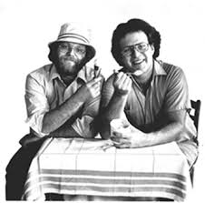
“I said…‘You know what business does, it’s harmful to the environment, it’s harmful to its employees,’” Ben said… And [Jerry] said, ‘Ben, if there’s something you don’t like about business, why don’t you just do it different?’”

Slide 6
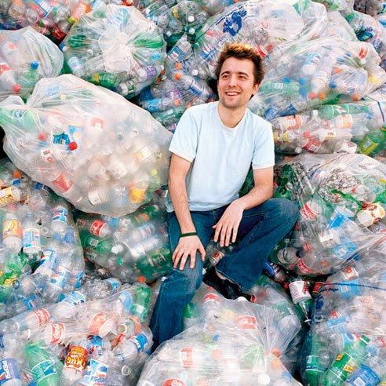
“Perhaps we can start seeing [waste] as a positive: an inherently valuable combination of materials that can be processed and shaped into objects with specific purposes.”

Slide 7
Ben & Jerry’s had always been extremely generous, giving 7.5% of pretax profits to its foundation and even more to the communities where it sold its products, and it had always treated its employees well.

Slide 8
“If we seriously limit our buying or exclusively buy used durable goods, we will likely negatively affect our economy… Are we willing to live with moderated economic growth in exchange for a healthier planet?”

Slide 9
Q & A
???

